Slide 1
Homeostasis

Slide 2
What conditions does the body need?
A stable internal environment
Temperature
Pressure
salt concentration
pH
etc.
Notes:
It gets this by:

Slide 3
Term: Homeostasis
“Normal operating conditions”
“the tendency of an organism or cell to regulate its internal environment and maintain equilibrium, usually by a system of feedback controls, so as to stabilize health and functioning”
Just remember “balance” and “equilibrium”

Slide 4
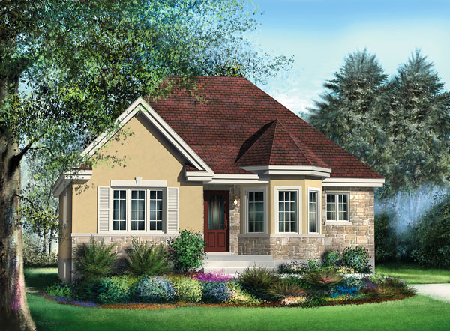
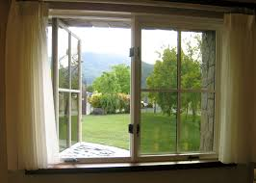
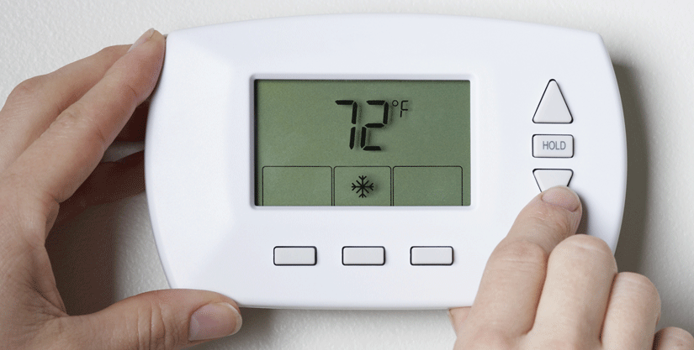
HOME - ostasis
Your home has systems built in to keep comfortable
Some may turn on automatically
Notes:
Your home has systems built in to keep comfortable (humidifier, lights, stove)
some may turn on automatically when environment changes (thermostat)

Slide 5
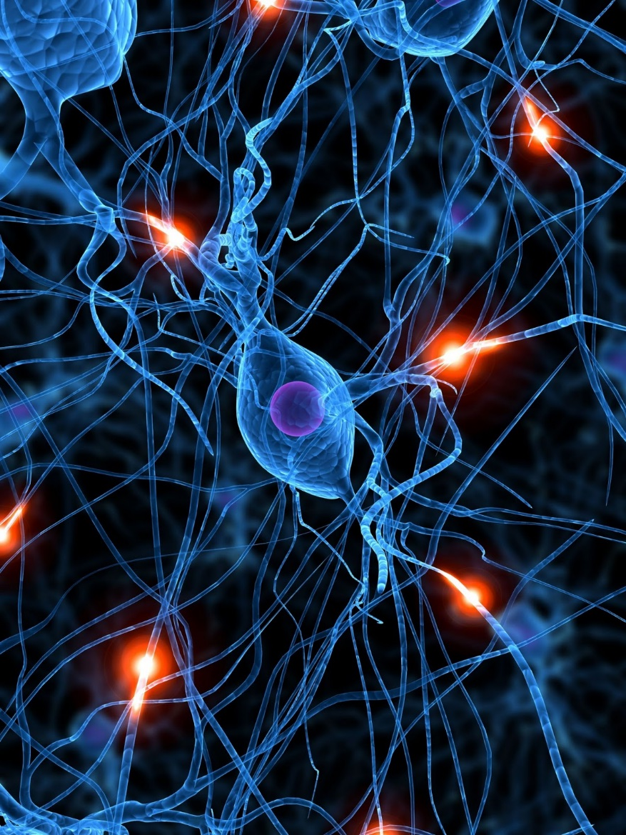
How your body maintains balance…
Receptors sense change
Receptors signal to control center to decide if there’s a need to adjust
Control center sends signal to effector to take action
Via afferent pathway
Via efferent pathway

Slide 6
How your body maintains balance…
Receptors sense change
Receptors signal to control center to decide if there’s a need to adjust
Control center sends signal to effector to take action
Via afferent pathway
Via efferent pathway

Slide 7
How your body maintains balance…
Receptors sense change
Receptors signal to control center to decide if there’s a need to adjust
Control center sends signal to effector to take action
Via afferent pathway
Via efferent pathway

Slide 8
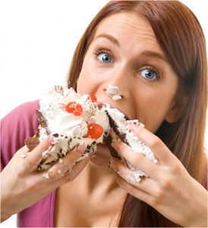
Feedback
Negative -
changes the variable back to its original state
A.k.a. output reduces the original effect

Slide 9
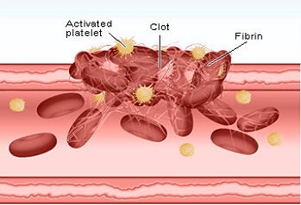
Feedback
Positive +
Output enhances original effect of the stimulus

Slide 10
https://www.youtube.com/watch?v=XZxuQo3ylII

