Slide 1
What are Invertebrates?

Slide 2
Invertebrates
In- (without) vertebra (joint of the spinal column)
Lack vertebrae
Rely on shells, glass spicules, exoskeletons and hydrostatic pressure
1.3 millions invertebrates

Slide 3
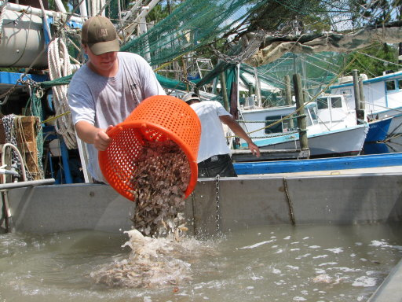
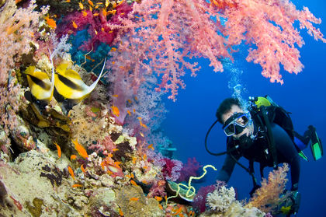
Importance of Invertebrates
Economically and commercially valuable
Shrimp largest commercial fishery ~$10 billion
Florida coral reef tourism $1.2billion annually

Slide 4
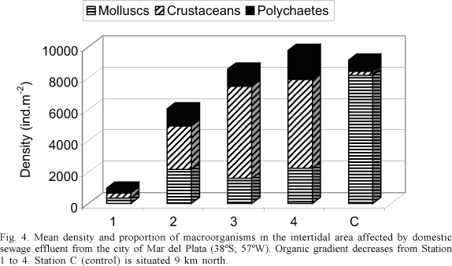
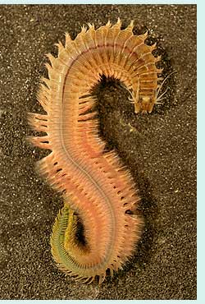
Importance of Invertebrates
Indicator species- environmental changes
Polychaetes indicate pollution in soft sediments

Slide 5
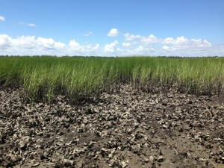
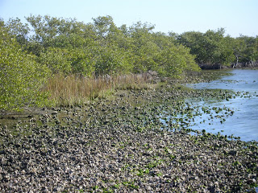
Importance of Invertebrates
Habitat Modifiers- generate habitat
Dense oyster beds stabilize sediment

Slide 6
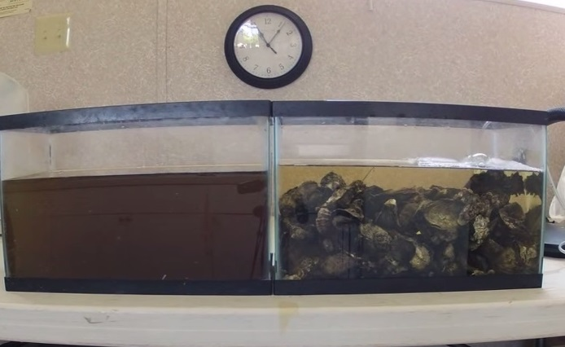
Importance of Invertebrates
Keystone Species- maintain diversity
Oysters water filtration – up to 15L per hour
decreases turbidity, removes bacterial biomass, reduced nitrogen and particulates such as carbon, phosphorus, nitrogen and silica, increased light penetration
Notes:
https://www.youtube.com/watch?v=saAy7GfLq4w

Slide 7
Phyla we will examine
Porifera
Cnidaria
Platyhelminthes
Nematoda
Annelida
Rotifera
Mollusca
Arthropoda
Echinodermata

Slide 8
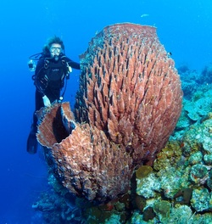
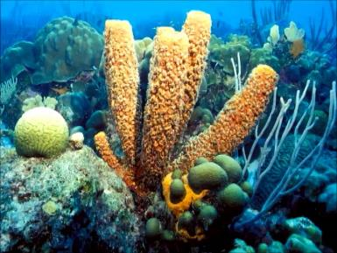
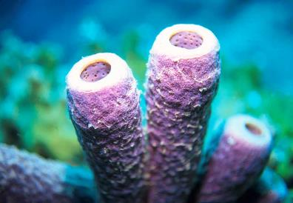
Porifera
Notes:
Pore bearer – some of the most simple - three distinct groups

Slide 9
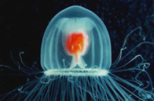
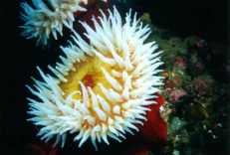
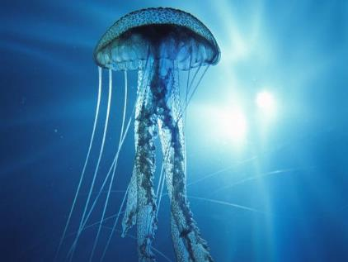
Cnidaria
Notes:
Stinging cells – special stinging cells

Slide 10
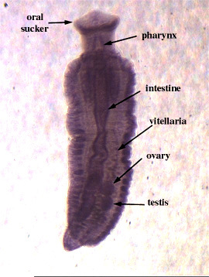
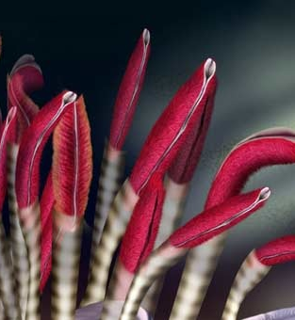
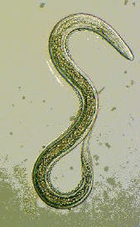
Platyhelminthes - Nematoda - Annelida
Notes:
Flatworm, roundworm, segmented worms

Slide 11
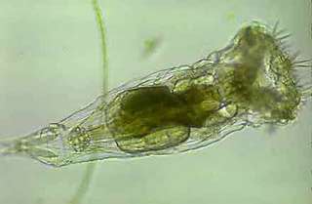
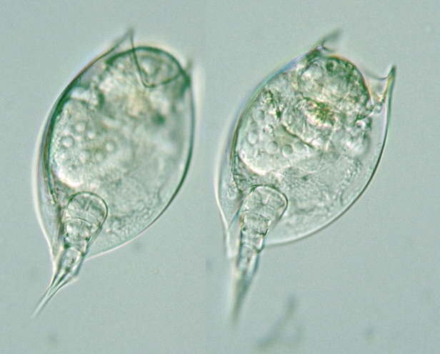
Rotifera
Notes:
Microscopic – rapidly revolving wheels

Slide 12
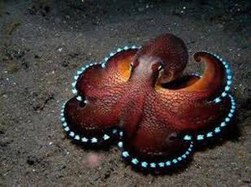
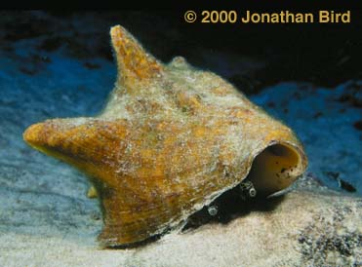
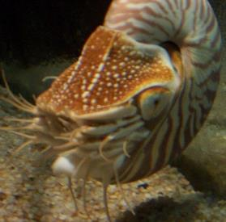
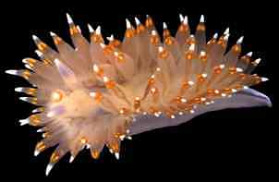
Mollusca
Notes:
Head foot -

Slide 13
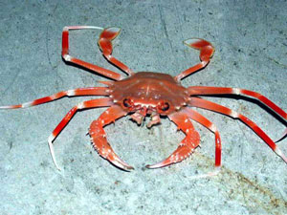
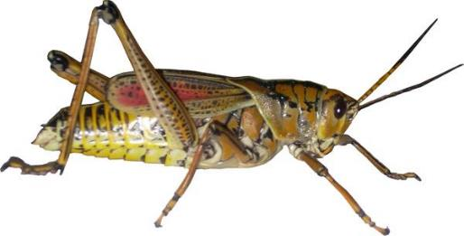
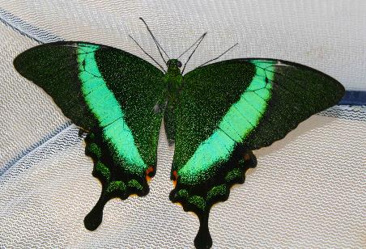
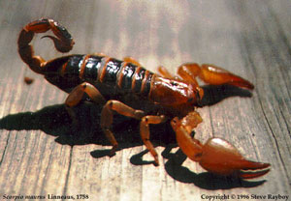
Arthropoda
Notes:
6-9 million species – jointed foot

Slide 14
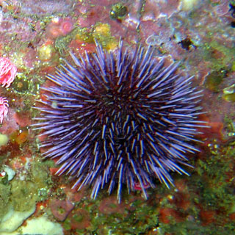
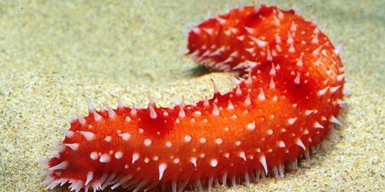
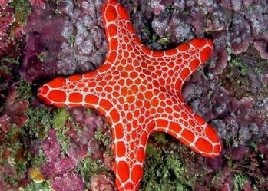
Echinodermata
Notes:
Spiny skin – largest phylum that’s mostly marine

